Slide 1
Accounts Receivable Review
BE 8-2, p 427

Slide 2
8
REPORTING AND ANALYZING RECEIVABLES
Accounting, Fifth Edition

Slide 3
Learning Objectives
After studying this chapter, you should be able to:
Identify the different types of receivables.
Accounts Receivable accounting issues:
Explain how accounts receivable are recognized.
Describe & compute the allowance methods for accounts receivable.
Write off of Accounts Receivable
Recovery of Accounts Receivable
Describe the principles of sound accounts receivable management (Steps 1-5).
Explain the statement presentation of receivables.
Compute the interest on notes receivable.
* Self-study

Slide 4
Types of Receivables
Amounts due from individuals and companies that are expected to be collected in cash.
Amounts customers owe on account that result from the sale of goods and services.
Written promise (formal instrument) for amount to be received. Also called trade receivables.
Nontrade receivables such as interest, loans to officers, advances to employees, and income taxes refundable.
Accounts Receivable
Notes Receivable
Other Receivables
LO 1 Identify the different types of receivables.

Slide 5
Accounts Receivable
Two accounting issues:
Recognizing accounts receivable.
Service organization – records a receivable when it performs services without immediate payment.
Merchandiser – records a receivable when merchandise is sold without immediate payment.
Valuing accounts receivable.
LO 2 Explain how accounts receivable are recognized in the accounts.

Slide 6
Recognizing Receivables – Sales on Account
Illustration: Assume that Jordache Co. on July 1, 2014, sells merchandise on account to Polo Company for $1,000 terms 2/10, n/30. Prepare the journal entry to record this transaction on the books of Jordache Co.
Jul. 1
Accounts receivable 1,000
Sales revenue 1,000
LO 2 Explain how accounts receivable are recognized in the accounts.

Slide 7
REVIEW: Recognizing Receivables – Sales Return & Payment on Receivables
Illustration: On July 5, Polo returns merchandise worth $100 to Jordache Co.
Jul. 5
Sales returns and allowances 100
Accounts receivable 100
Illustration: On July 11, Jordache receives payment from
Polo Company for the balance due.
Jul. 11
Cash 882
Sales discounts ($900 x .02) 18
Accounts receivable 900
LO 2 Explain how accounts receivable are recognized in the accounts.

Slide 8
Valuing Accounts Receivable
Uncollectible Accounts Receivable
Sales on account raise the possibility of
accounts not being collected.
Seller records losses that result from extending uncollectible credit as Bad Debts Expense.
Allowance for Doubtful Accounts is a contra-asset account used to track the monies set aside for bad debts.
The net amount considered collectible (valuation) is called “Net Realizable Value” (A/R – Allow for Doubtful Accts)
LO 3 Describe the methods used to account for bad debts.

Slide 9
Valuing Accounts Receivable
Methods of Accounting for Uncollectible Accounts
Direct Write-Off
Theoretically undesirable:
No matching.
Receivable not stated at net realizable value.
Not acceptable for financial reporting.
Allowance Method
Losses are estimated:
Better matching.
Receivable stated at net realizable value.
Required by GAAP.
Not GAAP
LO 3 Describe the methods used to account for bad debts.

Slide 10
Selling on Accounts Receivable
Journal entry for credit sale of $100?
Accounts receivable 100
Sales 100
Allowance for Doubtful Accounts (CA)
Accounts Receivable (A)
+
-
-
+
Beg. 39,800
100
528 Beg.
End. 39,900
528 End.

Slide 11
Recording Receipts on Accounts Receivable
Collected $300 on account?
Cash 300
Accounts receivable 300
Allowance for Doubtful Accounts (CA)
Accounts Receivable (A)
+
-
-
+
Beg. 39,800
528 Beg.
Sale 100
300 Coll.
End. 39,600
528 End.

Slide 12
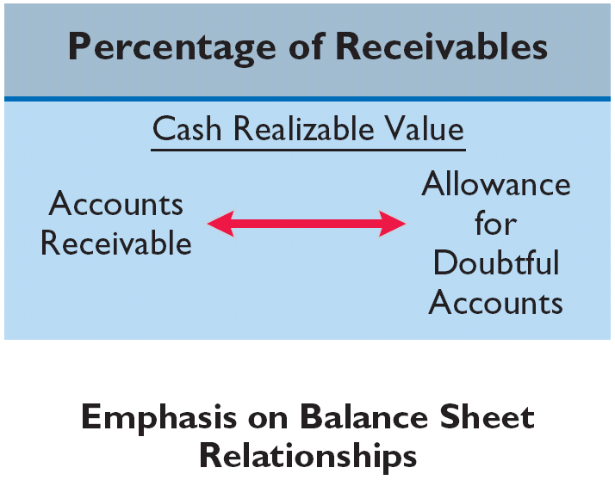
Valuing Accounts Receivable
Estimating the Allowance
Under the percentage of receivables basis, management establishes a percentage relationship between the amount of receivables and expected losses from uncollectible accounts.
Helpful Hint Where appropriate, the percentage-of-receivables basis may use only a single percentage rate.
LO 3 Describe the methods used to account for bad debts.

Slide 13
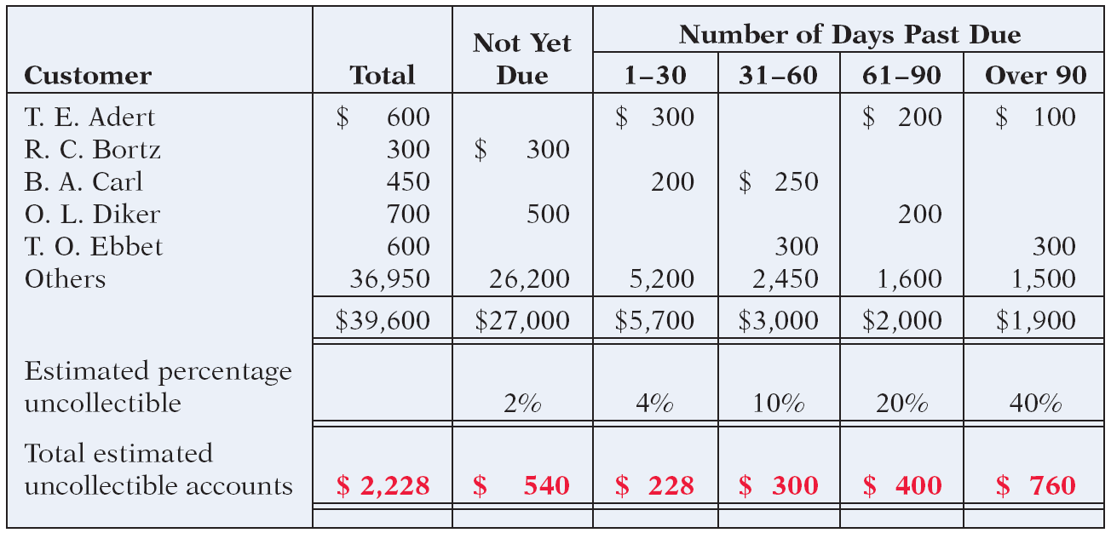
Valuing Accounts Receivable
Aging the accounts receivable - customer balances are classified by the length of time they have been unpaid.
Illustration 8-7
LO 3 Describe the methods used to account for bad debts.

Slide 14
Valuing Accounts Receivable
Estimating the Allowance
Illustration: Assume the unadjusted trial balance shows Allowance for Doubtful Accounts with a credit balance of $528. Prepare the adjusting entry assuming $2,228 is the estimate of uncollectible receivables from the aging schedule.
Dec. 31
Bad debt expense 1,700
Allowance for doubtful accounts 1,700
Illustration 8-8 Bad debts accounts after posting
LO 3 Describe the methods used to account for bad debts.

Slide 15
Allowance Method for Uncollectible Accounts
Allowance Method for Uncollectible Accounts
Companies estimate uncollectible accounts receivable.
To set aside reserves for uncollectible accounts:
Bad Debts Expense $xxx
Allowance for Doubtful Accounts $xxx
(a contra-asset account).
When a SPECIFIC account is determined uncollectible and written off:
Allowance for Doubtful Accounts $xxx
Accounts Receivable $xxx
Allowance for Doubtful Accounts (CA)
-
+
2.
3.
1.
LO 3 Describe the methods used to account for bad debts.

Slide 16
Adjusting Allowance for Doubtful Accounts
Adjustment of $1700 for estimated bad debts – when guesstimating uncollectible accounts.
Bad debt expense 1,700
Allowance for Doubtful Accounts 1,700
Allowance for Doubtful Accounts (CA)
Accounts Receivable (A)
+
-
-
+
Beg. 39,800
528 Beg.
Sale 100
300 Coll.
1,700 Est.
End. 39,600
2,228 End.
It is estimated that $2,228 of the $39,600 in A/R will never be collected.

Slide 17
Practice Problem – Estimated Allowance
E8-6, p 430 (part 1)
Create T accounts for Accounts Receivable & Allowance for Doubtful Accounts. Place the + and – on the correct side.
Input the opening balances.
Calculate the estimated Allowance for Doubtful Accounts. Input this amount into the T account as needed.
Create the journal entry to make the T-account in the step above balance.

Slide 18
Write off of Accounts Receivable
Write-off of uncollectible accounts for $600 – when confirmation of a R.A. Ware’s account is uncollectible.
Allowance for Doubtful accounts 600
Accounts receivable 600
Allowance for Doubtful Accounts (CA)
Accounts Receivable (A)
+
-
-
+
Beg. 39,800
528 Beg.
Sale 100
300 Coll.
1,700 Est.
600 W/O
W/O 600
End. 39,000
1,628 End.

Slide 19
Valuing Accounts Receivable
Recovery of an Uncollectible Account
Illustration: On July 1, R. A. Ware pays the $600 amount that Hampson Furniture had written off on March 1. Hampson makes these entries:
July 1
Accounts receivable 600
Allowance for doubtful accounts 600
1
Cash 600
Accounts receivable 600
Helpful Hint Like the write-off, a recovery does not involve the income statement.
LO 3 Describe the methods used to account for bad debts.

Slide 20
Recovery of Accounts Receivable
R.A. Ware later decides to pay off their account.
Accounts Receivable 600
Allowance for Doubtful Accounts 600
Cash 600
Accounts Receivable 600
Allowance for Doubtful Accounts (CA)
Accounts Receivable (A)
+
-
-
+
Beg. 39,800
528 Beg.
Sale 100
1,700 Est.
300 Coll.
W/O 600
Recovery 600
600 W/O
600 Recovery
600 Receipt
End. 39,000
2,228 End.

Slide 21
Practice Problem – Write off & Recovery
E8-6, parts 2 & 3, pg 430
Continue using the T-accounts you previously set up.
Write-off the $1,000 that has been confirmed to be uncollectible.
Lo and behold, the $1,000 that was determined uncollectible will now be paid.
Bring the account back onto the books (clue: undo what you did in Step 2.
Record the receipt of cash and reduction in accounts receivable for the $1,000.

Slide 22
Managing Receivables
Illustration 8-16
Excerpt from Sketchers’ note on concentration of credit risk
LO 7 Describe the principles of sound accounts receivable management.

Slide 23
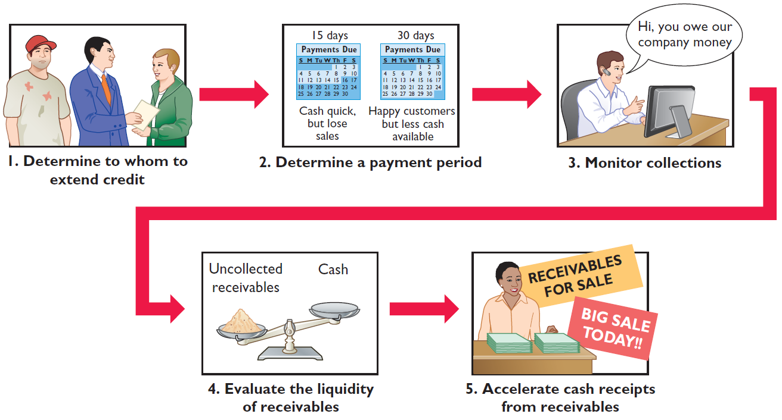
Managing Receivables
Managing accounts receivable involves five steps:
Illustration 8-19
Managing receivables
LO 9 Describe methods to accelerate the receipt of cash from receivables.

Slide 24
Step 1 - Managing Receivables
Extending Credit
If the credit policy is too tight, you will lose sales.
If the credit policy is too loose, you may sell to customer who will pay either very late or not at all.
It is important to check references on potential new customers as well as periodically to check the financial health of continuing customers.
LO 7 Describe the principles of sound accounts receivable management.

Slide 25
Step 2 - Managing Receivables
Establishing a Payment Period
Companies should determine a required payment period and communicate that policy to their customers.
The payment period should be consistent with that of competitors.
LO 7 Describe the principles of sound accounts receivable management.

Slide 26
Managing Receivables – Step 3
Monitoring Collections
Companies should prepare an accounts receivable aging schedule at least monthly.
Helps managers estimate the timing of future cash inflows.
Provides information about the collection experience of the company and identifies problem accounts.
Significant concentrations of credit risk must be discussed in the notes to its financial statements.
LO 7 Describe the principles of sound accounts receivable management.

Slide 27
Step 4 - Managing Receivables
Evaluating Liquidity of Receivables
Accounts Receivable Turnover:
Assess the liquidity of the receivables.
Measure the number of times, on average, a company collects receivables during the period.
Average collection period:
Used to assess effectiveness of credit and collection policies.
Collection period should not exceed credit term period.
LO 8 Identify ratios to analyze a company’s receivables.

Slide 28
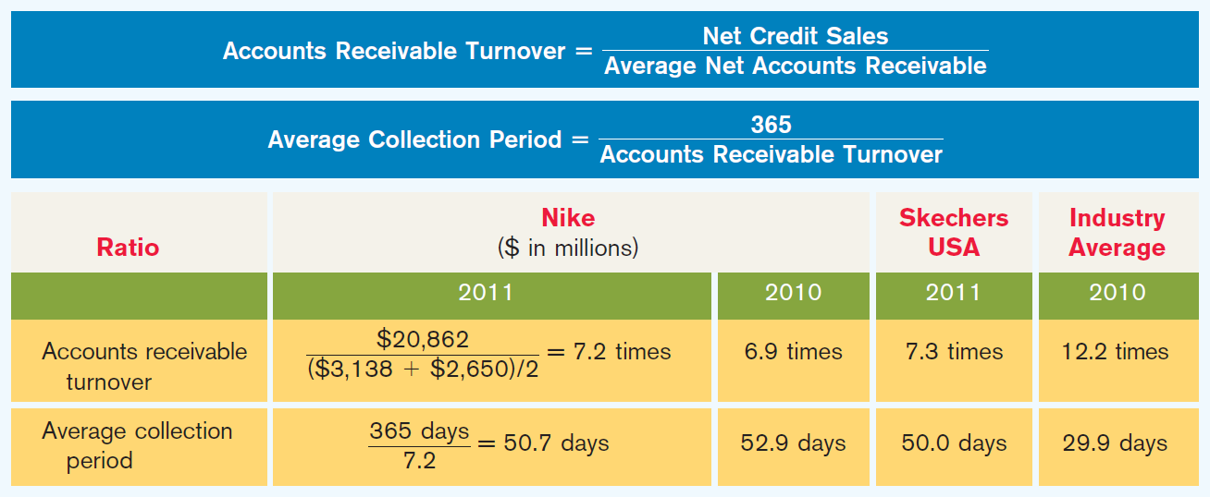
Step 4 - Financial Statement Presentation –
Evaluating Liquidity of Receivables
Data from Nike (in millions)
Illustration 8-17
LO 8 Identify ratios to analyze a company’s receivables.

Slide 29
Step 5 - Managing Receivables
Accelerating Cash Receipts
Accept credit cards
Sell accounts receivables for an amount less than the amount owed from its customers
Cash 588,000
Service charge expense 12,000
Accounts receivable 600,000
LO 9 Describe methods to accelerate the receipt of cash from receivables.

Slide 30
Step 5: Credit Card Sales
Accepting credit cards are helpful to retailers because:
Helps to increase sales.
Credit risk is transferred to the credit card issuer.
The retailer avoids having to evaluate a customer’s credit standing for each sale; this responsibility is transferred to the credit card issuer.
Three parties involved when credit cards are used.
credit card issuer,
Retailer (who pays 2-4% to the credit card issuer),
customer.
LO 9 Describe methods to accelerate the receipt of cash from receivables.

Slide 31
Credit Card Sales on Store Cards
Illustration: Some retailers issue their own credit cards. Assume that you use your JCPenney Company credit card to purchase clothing with a sales price of $300.
Accounts receivable 300
Sales revenue 300
Assuming that you owe $300 at the end of the month, and JCPenney charges 1.5% per month on the balance due
Accounts receivable 4.50
Interest revenue 4.50
LO 2 Explain how accounts receivable are recognized in the accounts.

Slide 32
Credit Card Sales on Visa/MasterCard
National Credit Card Sales
Illustration: Morgan Marie purchases $1,000 of compact discs for her restaurant from Sondgeroth Music Co., and she charges this amount on her Visa First Bank Card. The service fee that First Bank charges Sondgeroth Music is 3%.
Cash 970
Service charge expense 30
Sales revenue 1,000
LO 9 Describe methods to accelerate the receipt of cash from receivables.

Slide 33
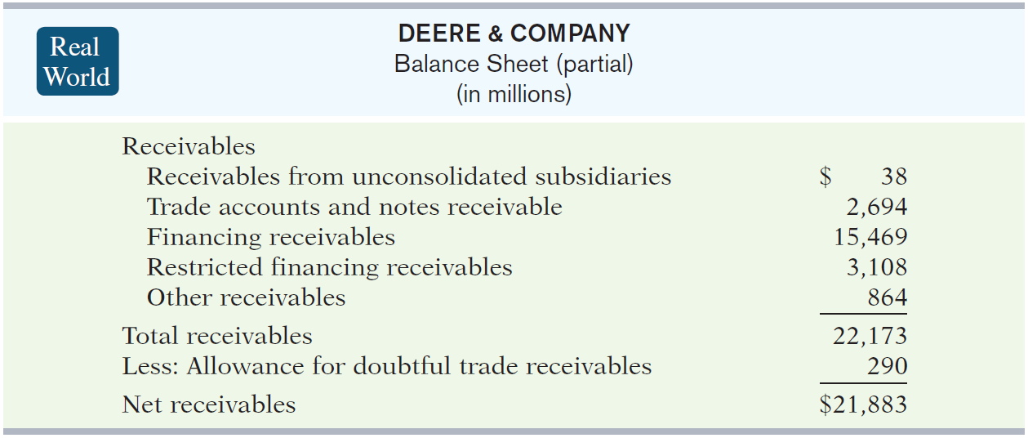
Financial Statement Presentation
Illustration 8-14
Balance sheet presentation
of receivables
LO 6 Explain the statement presentation of receivables.

Slide 34
Valuing Accounts Receivable
Illustration 8-9 Sketchers USA’s note disclosure of accounts receivable
LO 3 Describe the methods used to account for bad debts.

Slide 35
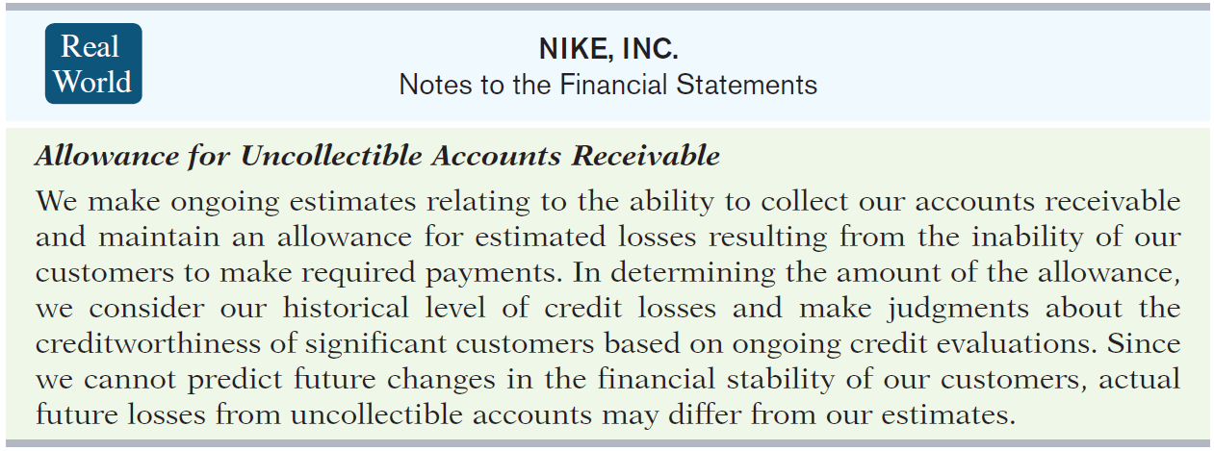
Valuing Accounts Receivable
Estimating the Allowance
Illustration 8-6 Nike’s
allowance method disclosure
LO 3 Describe the methods used to account for bad debts.

Slide 36
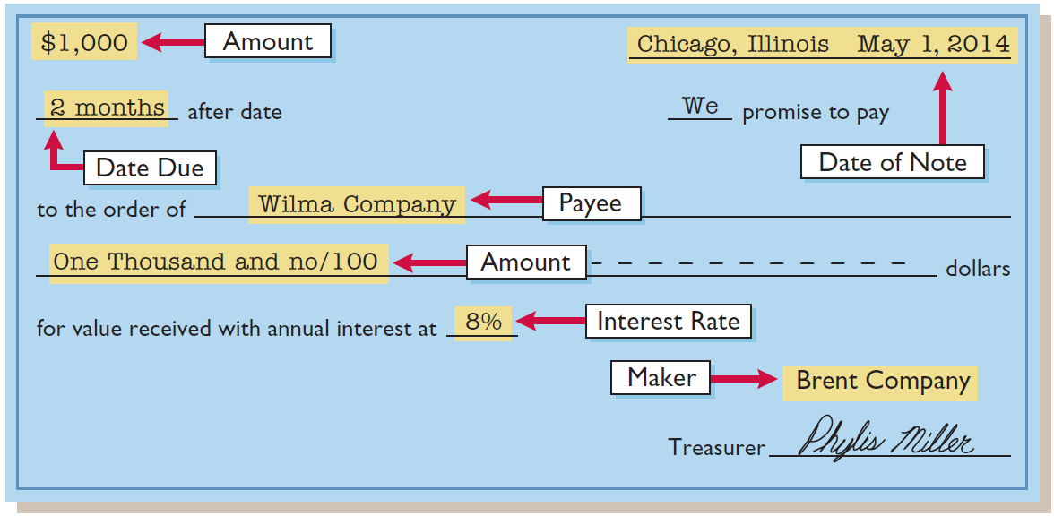
Notes Receivable
To the payee (Wilma Company), the promissory note is a note receivable.
To the maker (Brent Company), the promissory note is a note payable.
Nov 1
Notes receivable 10,000
Accounts receivable 10,000
Illustration 8-10
LO 4 Compute the interest on notes receivable.

Slide 37
Notes Receivable
Illustration: Wolder Co. lends $10,000 on June 1, accepting a five-month, 9% interest note. If the note is paid on November 1, the maturity date, the entry to record the collection is:
Nov. 1
Cash 10,375
Notes receivable 10,000
Interest revenue 375
($10,000 x 9% x 5/12 = $375)*
*Computing Interest
Illustration 8-11
LO 4 Compute the interest on notes receivable.

Slide 38
Notes Receivable
Computing Interest Examples
Illustration 8-12
LO 4 Compute the interest on notes receivable.

Slide 39
Notes Receivable
Accrual of Interest Receivable
Illustration: Suppose instead that Wolder Co. prepares financial statements as of September 30. The adjusting entry by Wolder is for four months ending Sept. 30.
Illustration 8-13
Sept. 30
Interest receivable 300
Interest revenue 300
($10,000 x 9% x 4/12 = $ 300)
LO 5 Describe the entries to record the disposition of notes receivable.

Slide 40
Notes Receivable
Accrual of Interest
Illustration: Prepare the entry Wolder’s would make to record the honoring of the note on November 1.
Nov. 1
Cash 10,375
Notes receivable 10,000
Interest receivable 300
Interest revenue 75
(10,000 x 9% x 1/12 = $75)
LO 5 Describe the entries to record the disposition of notes receivable.

Slide 41
Practice Problem – Notes Receivable
E8-8, p 431
Record the Note Receivable (N/R). Note: CR Cash
Calculate the accrued interest income as of Dec 31. Remember that the N/R originated on May 1. Record the journal entry.
Record the cash received on May 31, 2014. Be sure to include the information in Step 2 in the journal entry.

